Slide 1

A Guide to
Spectroradiometry
Leslie Lyons
Technical Support Manager
Bentham Instruments Limited
The Light Measurement Company
www.bentham.co.uk

Slide 2
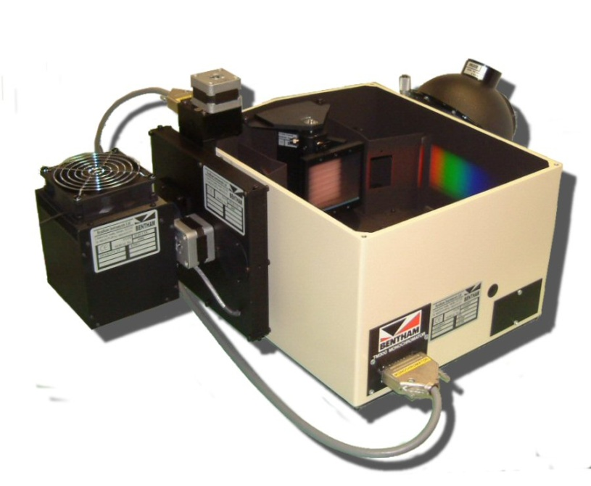
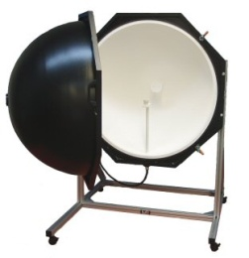
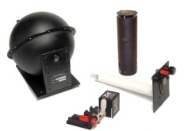
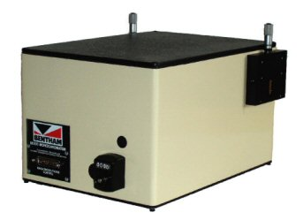
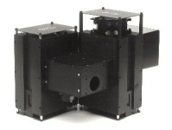
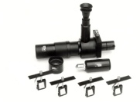

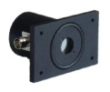
Bentham Instruments Ltd
Bentham Instruments offers over 30 years extensive experience in the manufacture and supply of standard instruments and custom systems for applications involving the study and measurement of light.
Our established customer base includes many blue chip organisations , highly respected university research departments, National Metrology Institutes worldwide, etc. We pride ourselves on supplying them with reliable and accurate instrumentation.
Established: 1975
Employees: 15
Privately owned (GBP 1.75M shareholders funds available)
The Light Measurement Company
www.bentham.co.uk

Slide 3
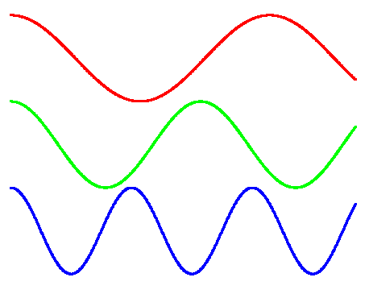
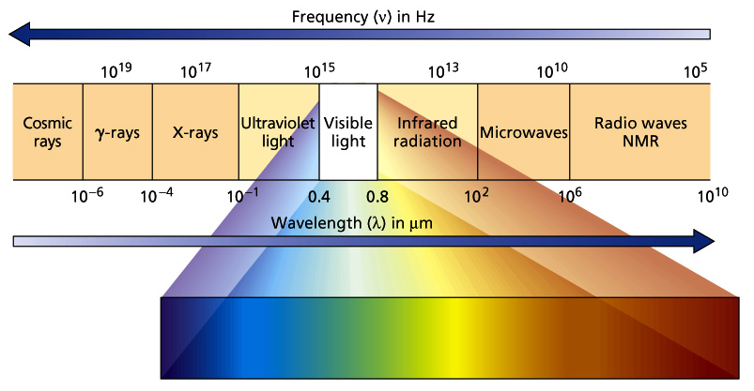
The Nature of Light
Electromagnetic radiation
Light exists as photons displaying both wave and particle properties
Discrete quanta of energy
Energy inversely proportional to wavelength
Measurements in 200nm-50µm range of EM spectrum
Monochromator Operation
www.bentham.co.uk

Slide 4
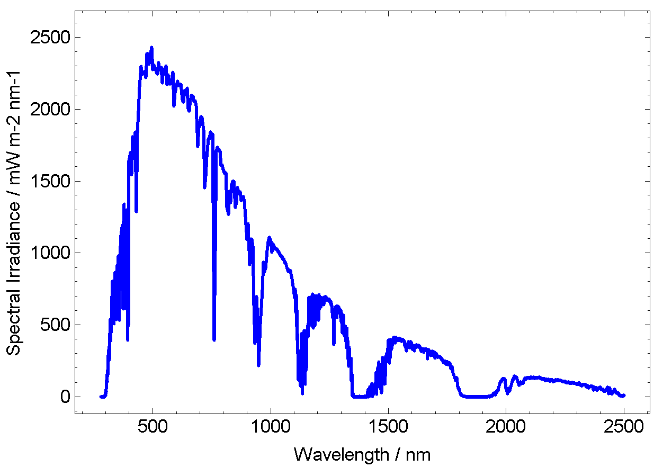
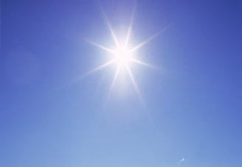
Broadband Emission
Light emitted from sources combination of finite number of wavelengths
Require to determine spectrum of source, component at each wavelength
Disperse- separate component wavelengths
Monochromator Operation
www.bentham.co.uk

Slide 5
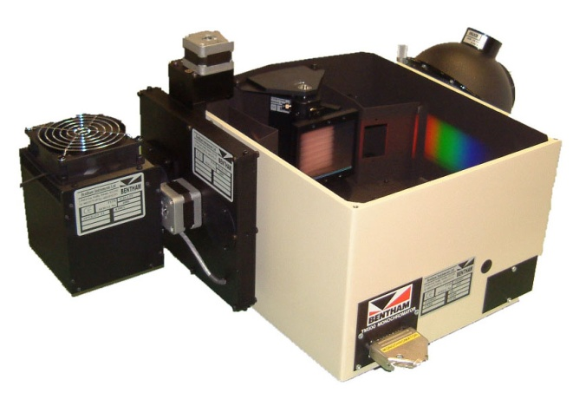
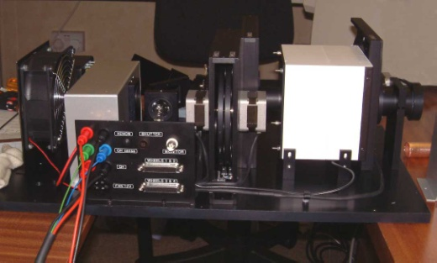
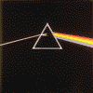
The Dispersion of Light
Monochromator-
Low throughput
High spectral resolution
Filter based-
High throughput
Low spectral resolution
Monochromator Operation
Prism-
Limited spectral range
Non-linear dispersion
www.bentham.co.uk

Slide 6
Czerny- Turner Configuration
Light input at entrance slit at distance f from concave mirror
Light collimated by concave mirror, focal length, f
Reflection grating disperses light
Second concave mirror re-focuses light onto exit slit
Rotate grating to select another wavelength
Monochromator Operation
www.bentham.co.uk

Slide 7
Diffraction Gratings
Diffraction grating consists of thousands of etched terraces (~1000/mm)
Each terrace reflects incident light; interference of light from adjacent terraces
Rotate grating to select wavelength
Ruled gratings produced by mechanical means; high efficiency but potentially high stray light component
Holographic gratings produced by holographic exposure of photoresist followed by chemical etch; lower efficiency, low stray light
Monochromator Operation
www.bentham.co.uk

Slide 8
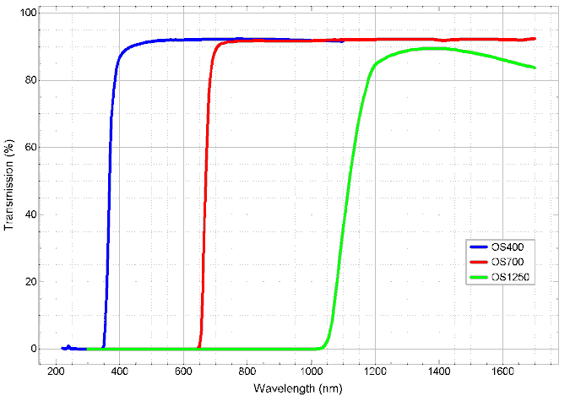
Order Sorting
“Two- rainbow effect”
Grating equation nλ =dsinθ
n, diffraction order
Wish to measure only 1st order
Suppress higher orders (lower wavelengths)
Insert long pass filters
Monochromator Operation
www.bentham.co.uk

Slide 9
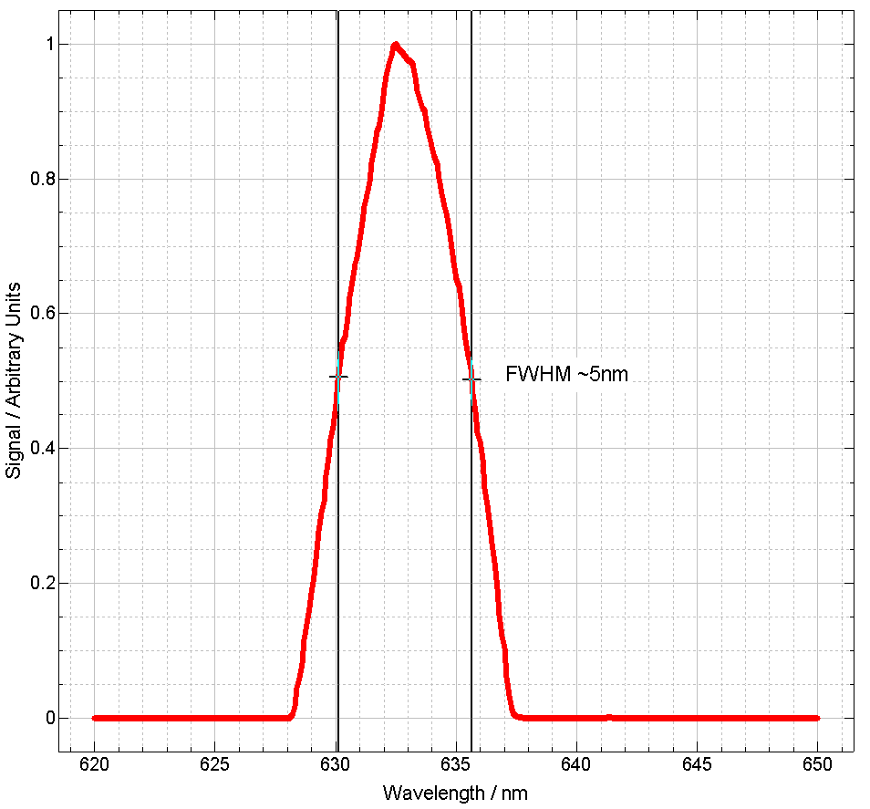
Diffraction Grating Line Density (g/mm) | Dispersion in TMc300 (nm/mm) | Recommended Spectral Range of Use (nm)
2400 | 1.35 | 200-600
1800 | 1.8 | 250-800
1200 | 2.7 | 300-1200
600 | 5.4 | 1000-2500
Bandwidth
Imaging optical system
Entrance port imaged at exit in infinity of monochromatic images
Plane of exit port wavelength axis
System bandwidth defined by largest aperture
Bandwidth determined as FWHM of line source
Impact on spectral resolution
Impact upon system throughput
Varies with grating line density
Monochromator Operation
Diffraction Grating Line Density (g/mm) | Dispersion in TMc300 (nm/mm) | Recommended Spectral Range of Use (nm)
2400 | 1.35 | 200-600
1800 | 1.8 | 250-800
1200 | 2.7 | 300-1200
600 | 5.4 | 1000-2500
www.bentham.co.uk

Slide 10
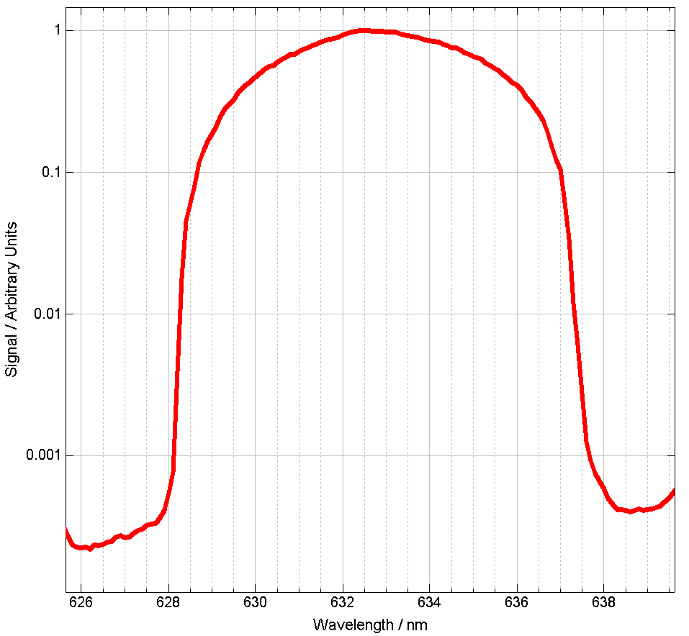
Slit Function
Provides information on “near field” scatter
Measurement of line source
Consideration of system response away from selected wavelength
For sources with sharp changes, may be of import
Monochromator Operation
www.bentham.co.uk

Slide 11
Stray Light
White light to be measured input to monochromator
Some white light reflected off the beaten track- mirror mounts etc.
At exit port is presented selected wavelength and some white “stray” light
Where signal to be measured smaller than stray light problem shall be seen
Monochromator Operation
www.bentham.co.uk

Slide 12
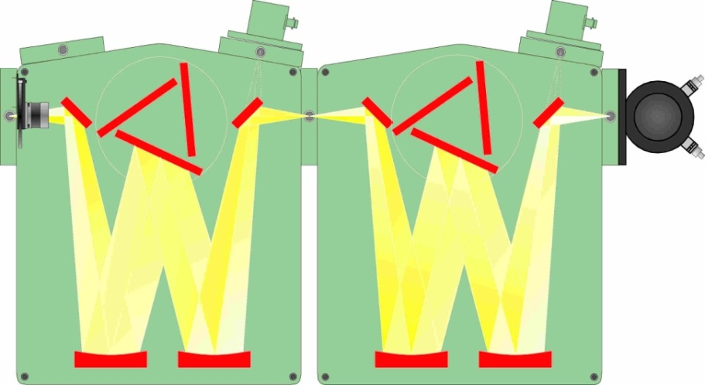
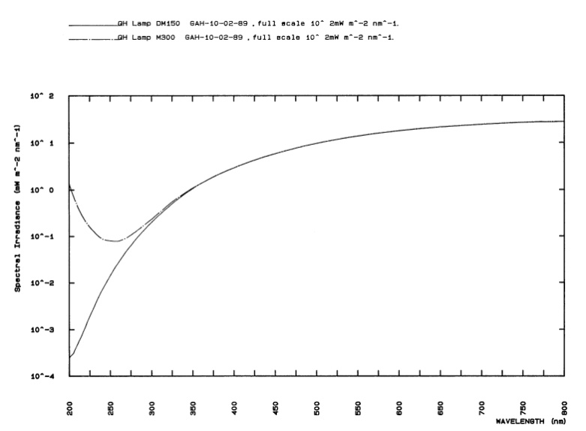
Double Monochromator
Pass output of first monochromator through second device
Re-disperse selected wavelength and stray light component
Re-select desired wavelength
Stray light performance effectively squared
Triple monochromator for extreme instances (eg. Raman)
Monochromator Operation
www.bentham.co.uk

Slide 13
Definitions
Spectroradiometer An instrument for measurement of radiometric quantities in narrow wavelength
intervals over a given spectral region (CIE)
e.g. irradiance, radiance, etc
Spectrophotometer An instrument for measurement of the ratio of two values of a radiometric
quantity at the same wavelength (CIE)
e.g. transmission, reflection, absorption
Spectrometer More generic, incorporates wavelength dispersion, spectral features
e.g. as above, AA, OES, LIBS, fluorimeters, Raman etc.
Monochromator Applications
www.bentham.co.uk

Slide 14
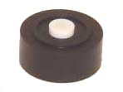
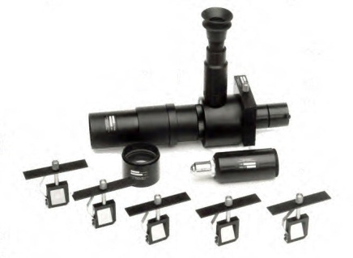
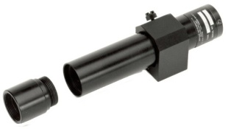
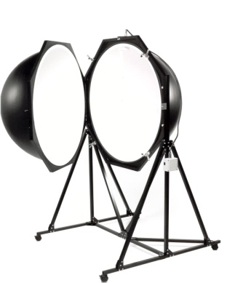
Spectroradiometer Measurement Quantities
Typical input optic
Diffuser
Telescope
Baffled Tube
Integrating
Sphere
Measurement Quantity | Unit | Photometric Parameter | Photometric Unit
Spectral irradiance | mW/(m².nm) | Illuminance | lux
Spectral radiance | mW/(sr.m².nm) | Luminance | cd/m²
Spectral radiant intensity | mW/(sr.nm) | Luminous intensity | cd
Spectral total radiant flux | mW/nm | Total luminous flux | lumens
Spectroradiometry
www.bentham.co.uk
14

Slide 15
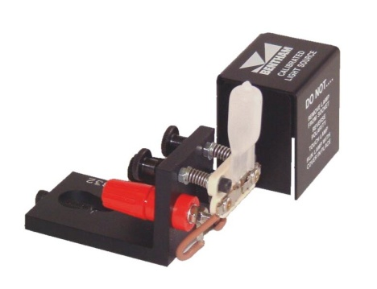
Spectral Irradiance
Power arriving at a surface from entire hemisphere above
Irradiance reduces with cosine of incident angle
Irradiance reduces with increasing distance
1/r² relation for point sources
Input optic cosine response, 2π field of view
Calibrate against standard of irradiance at given distance
Spectroradiometry
www.bentham.co.uk

Slide 16
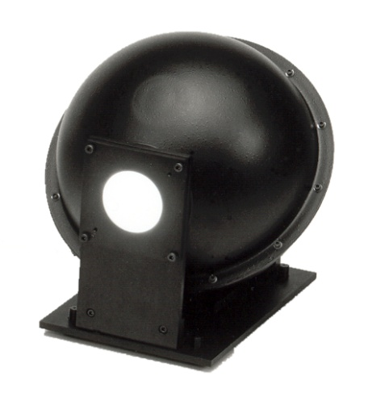
Spectral Radiance
Power emitted from a source per unit area into unit solid angle
Radiance is not dependant on distance
Sometimes termed brightness
Quantity measured of displays
Measured using imaging technique
Source must overfill field of view to measure absolute radiance
Calibrate against standard of spectra radiance
Spectroradiometry
www.bentham.co.uk

Slide 17
Field of View
Image source onto measurement plane
Select appropriate aperture at measurement plane
For non-uniform sources, image brightest part
In certain instances, field of view is larger than source- measure therefore average radiance over FOV
Aperture stop, D
Spectroradiometry
d, aperture
(field stop)
α
eff
α
eff
Solid angle,
Ω
Image
dis-
Object distance, H
tance, h
www.bentham.co.uk

Slide 18
Spectral Radiant Intensity
Power emitted from a source into unit solid angle
Quantity measured of point source signals
Sometimes termed brightness
Measured using imaging technique with source under-filling field of view (do not sample area)
Measured as an irradiance, multiplied by distance squared
Calibrated against standard of spectral radiant intensity
Spectroradiometry
www.bentham.co.uk

Slide 19
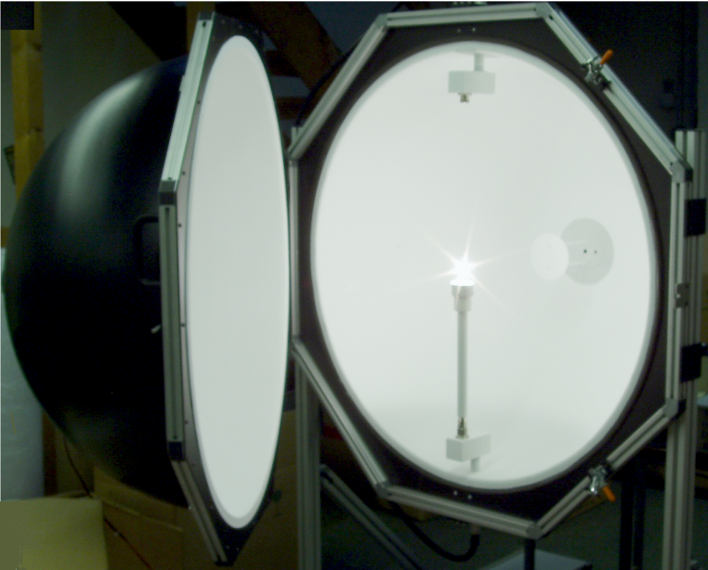
Total Spectral Radiant Flux
Total output of lamp
Use integrating sphere to collect all emitted light
Measurement in W nm-1
Calibrate against standard of total spectral radiant flux
Spectroradiometry
www.bentham.co.uk

Slide 20
Transmission
Colorimetry
www.bentham.co.uk

Slide 21
Total Spectral Radiant Flux
Plane diffraction grating
Concave mirror
Scanning grating
One wavelength at exit at time
Spectrophotometry
www.bentham.co.uk

